Slide 1
Student
Institution
Instructor
Course
Date

Slide 2
Descriptive Statistics
Notes:
Welcome!

Slide 3
Descriptive Statistics-Introduction
Descriptive statistics is used in analyzing and represent the data that have been collected previously, (Mendenhall et al, 2016).
It incorporates ranges, frequency counts, means, modes and median scores and standard deviation.
The imperative concepts to understand in descriptive statistics are variables and distribution.
Notes:
This is the introduction section of the entire presentation. As per the slide, the Descriptive statistics is used in analyzing and represent the data that have been collected previously.

Slide 4
Variables and Distributions
Variables- are things that are taken into account in the study, including distinct possibilities and distinct aspects that are to be studied.
There are three types of variables;
Nominal variables
Ordinal variables
Interval variables
The distribution on the other hand is a pattern of data collected that is used for easy analysis.
Notes:
This slide presents the definition and examples of variables and distribution.

Slide 5
Reliability
Reliability, in descriptive statistics is measure of the extend to which the instrument administered is going to yield the same type of results after several trial.
The reliability can be ascertained using test-retest method, inter-rarer reliability, split-halves method, internal consistency method and alternative form method.
Moreover, in estimation of the reliability of the study, the Spearman-Brown Correction is basically to be applied.
Notes:
The slide presents the reliability as it is applied in the descriptive statistics. More point to mention, the inter-rarer reliability involves analyzing two or more observations of study and coming up with the agreement of the observations. In this instance, the Kappa values are calculated.

Slide 6
Validity
Validity goes hand in hand with reliability, which are two important aspects that are used when designing a survey instrument.
Validity, as it is used in descriptive statistics, is used to refer to the extent to which the instrument used measures what is designed to measure.
There are three types of validity in research;
Criterion-related validity
Construct validity
Content validity
Notes:
This slide presents the validity of a descriptive statistics. It also gives three types of validity. Validity is used hand in hand with the correlation.

Slide 7


Mean, Mode and Median
Mean, mode and median are measures of central tendencies.
The measures of central tendencies are also known as averages.
Mean is used for both continuous and discrete data, though is mostly used for the continuous data, (McEwen et al, 2015).
It is measured by adding all the values and dividing by the number of values.
The formula for sample mean is: or
Notes:
This slide shows mean, mode and median.

Slide 8
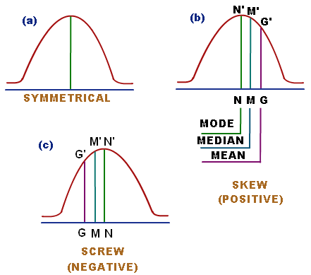
Mean, Mode and Median
Notes:
The graphs above shows the relationship between Mean, Mode and Median.

Slide 9
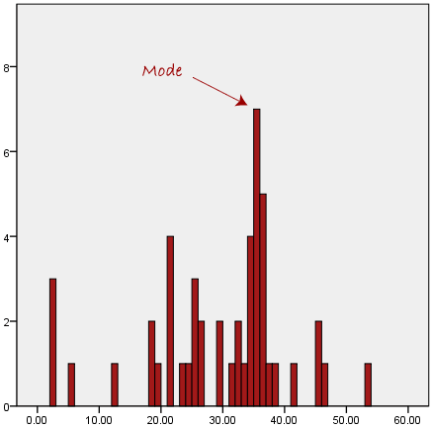
Mean, Mode and Median
Mode is the most frequent or common data.
On histogram or bar chart, the most frequent data is the highest bar.
Notes:
This slide shows the mode as a measure of central tendency.

Slide 10
Mean, Mode and Median
Median is the middle score of the set of data that is already arranged in order of magnitude, either in ascending or descending order.
The median is not easily affected by the outliers and skewed data.
For example; suppose we have the following data.
The first step is to arrange the data in order of magnitude, in my case I will use ascending order.
In this case, the median mark is the one at the middle. Which is 56.
Notes:
This slide shows the median, as measure of central tendency. It also gives example of how to find the median of a set of data.

Slide 11

Standard Deviation
Standard deviation is a measurement that is used in descriptive statistics basically to quantify data dispersion in a set of values.
Standard deviation can only me calculated after the mean is calculated, since it represents the percentage of the data collected.
The lower the standard deviation, the closer the data to mean and the higher the standard deviation, the wider the range values of data.
The formula for the standard deviation is as follows.
Notes:
The slide presents standard deviation as it is used in descriptive statistics. As mentioned in the slide, Standard deviation can only me calculated after the mean is calculated, since it represents the percentage of the data collected.

Slide 12
Bell Curve
Bell curve is a type of variable representation which is also known as normal distribution.
The term bell-curve emanates from the fact that the graph used to display normal distribution in a bell-shaped line.
The top most part of the curve shows the most probable event in a series of variable data, while the rest represents the most probable events.
Notes:
This section gives a brief summary of what the bell-curve is. More point to mention, the shape of the bell curve is provided by the underlying standard deviation from median and mode of the given data.

Slide 13
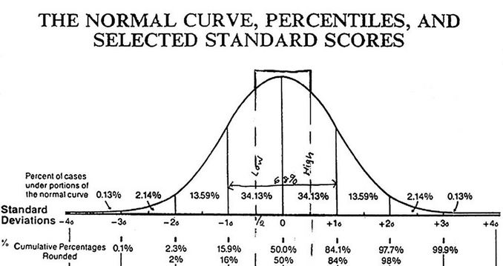
Bell- Curve
Notes:
The figure in the slide shows the Bell-Curve and it’s relationship with mean and standard deviation.

Slide 14
Standard Scores
Standard scores are mainly used to place scores for any individual on any variable set of data having any standard deviation and mean on the same standard scale for easy comparison, (Hinton, 2014).
Thus, the standard scores are used in making the comparison of the individuals and variables easier.
The standard scores are calculated by transforming the raw score to common scale.
It is based on normal distribution, using both standard deviation and mean.
Notes:
This slide expounds more about the standard scores.

Slide 15
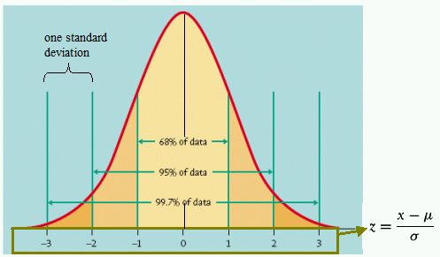
Standard Scores
Notes:
In the slide, the black line is the mean, while the Turquoise lines represents the standard deviation.

Slide 16
Test Scores
The test score refers to an information that is used as a summary of the prove contained in an examinee’s responses, to the test of items that are related to constructs being measured, (Green and Salkind,2016).
They can be interpreted with norm-referenced or criterion-referenced interpretation, or both.
The norm-referenced interpretation states that the scores depicts the meaning about the examinee with regard to other examinees.
Criterion-referenced interpretation states that the score depicts the information about the examinee with regard to some specific subject matter, without regarding other examinees.
There are two types of test scores, raw scores and scaled scores.
Notes:
This slide gives some information about test-score. Basically, there are two types of test scores, raw scores and scaled scores.

Slide 17
Test Scores
Raw scores are the type of scores that doesn’t have any sort of transformation or adjustments, such as simple number of questions answered correctly.
Scaled score on the other hand is used to represent the sum-total correct questions that candidate has answered that have been converted onto a standardized scale and a consistent scale.
Notes:
This slide gives the difference between the raw scores and scaled score.

Slide 18
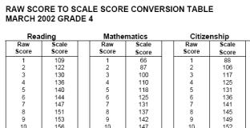
Test Scores
Notes:
The data in the slide shows the difference between the raw score and scaled score. Retrieved from; https://www.google.com/search?q=diagram+showing+scaled+scores+and+raw+scores&source=lnms&tbm=isch&sa=X&ved=0ahUKEwjZx-DFiqTdAhVSvxoKHd5ABU0Q_AUICigB&biw=1366&bih=672#imgrc=C_Wc-7yIud6TWM:

Slide 19

T-Scores
T-scores is a standardized score on each dimension for any type.
The score of 50 is used to represent the mean, while the difference of 10 from the mean is used to represent one standard deviation.
The score of 60 represents one standard deviation that is above mean, while 30 is two standard deviation below the mean.
The T-score formula is
x̄ = sample mean
μ₀ = population mean
s = sample standard deviation
n = sample size
Notes:
The slide presents the T-score and goes ahead to give the formula of calculating it.

Slide 20

Z- Score
The difference between the T-score and Z-score is that, the Z score is uses standard deviation that is derived from the entire population, while t score uses the standard deviation that is derived from the sample.
Z score has a mean of zero (0) and a standard deviation that is equal to one (1).
Z score is defined as the number of standard deviations from the mean a data is.
The formula for calculating Z-score is as follows.
Notes:
This slide shows the Z-score. It goes ahead to give the formula used in calculating it.

Slide 21
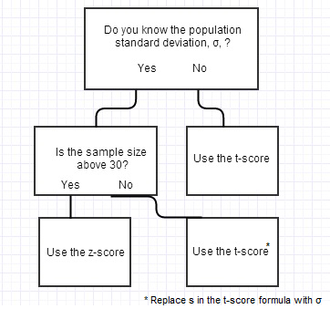
Chart for Using Either T score and Z score
Notes:
The chart in this slide is going to help you when deciding whether to use Z-score or T-score

Slide 22

Percentile
Percentile is a measure that is used in descriptive statistics to show the value below which a certain value lies in the observation group.
The term percentile and percentile rank are related, in which are used in reporting scores of norm-referenced tests.
25th percentile is also known as first quantile and is denoted Q_{1,}
50th percentile is the data median, which is also denoted as Q_{2,} while 75th percentile as the third quartile (Q₃).
The percentile is calculated by first obtaining the ordinal rank and then taking the value that is corresponding to that rank.
Ordinal rank is calculated by the following formula;
Notes:
This slide shows the percentile. As per the slide, Percentile is a measure that is used in descriptive statistics to show the value below which a certain value lies in the observation group.

Slide 23
Conclusion
In conclusion, the descriptive statistics is uses two main methods to represent the data, i.e. numerical and graphical method.
Numerical method includes mean, standard deviation, ranges, etc.
The graphical method include creating the Box Plot and stem and leaf display .
The descriptive statistic is a prerequisite to be carried out before inferential statistics.
Notes:
This part concludes the entire project presentation. As per the slide, the descriptive statistic is a prerequisite to be carried out before inferential statistics.

Slide 24
References
Green, S. B., & Salkind, N. J. (2016). Using SPSS for Windows and Macintosh, Books a la Carte. Pearson.
Mendenhall, W. M., Sincich, T. L., & Boudreau, N. S. (2016). Statistics for Engineering and the Sciences, Student Solutions Manual. Chapman and Hall/CRC.
McEwen, W., & Dean, I. E. (2015). Riverside City College Descriptive Statistics for Math Placement and Math Success 2014-2015.
Hinton, P. R. (2014). Statistics explained. Routledge.
Notes:
Goodbye!

